Slide 1


Machine Learning
Pascal van de Wijdeven

Slide 2


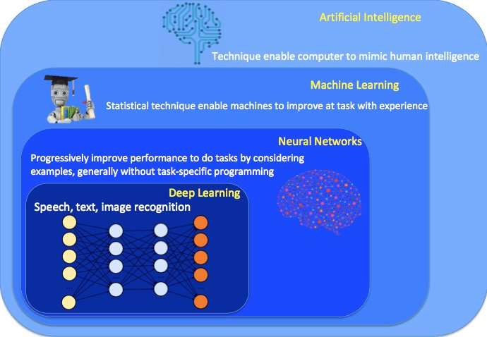
AI, ML, DL

Slide 3
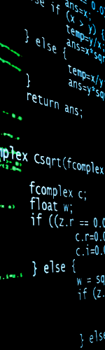
What is Machine Learning?
Field of study that gives computers the ability to learn
without being explicitly programmed

Slide 4
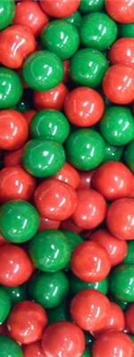
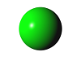


ML versus programming
B
A
A
B
A
B
Programming:
If Marble=GREEN Then Name=“A” If Marble=RED Then Name=“B”
B
?
Machine Learning:
- Look at currently available marbles - Looking at the features (e.g. RGB value), what would be the best possible name?
B
B

Slide 5
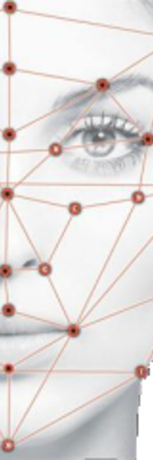


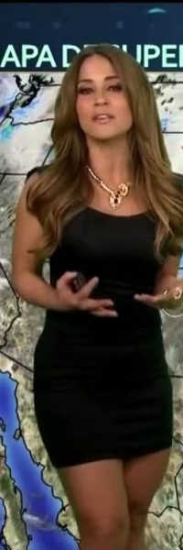
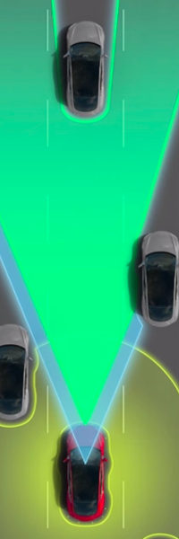
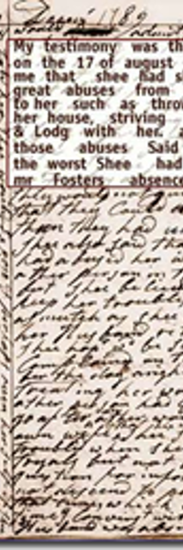
Where is ML used?
Recommender systems
OCR
Fraud detection
Face recognition
Self driving vehicles
Weather forecast

Slide 6
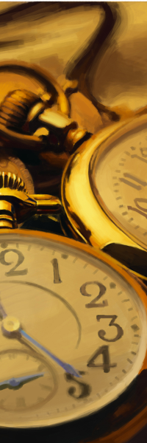
From description to prescription
Description What happened?
Diagnostic What is happening and why?
Prediction What will happen and when?
Prescription How can we make it happen?

Slide 7
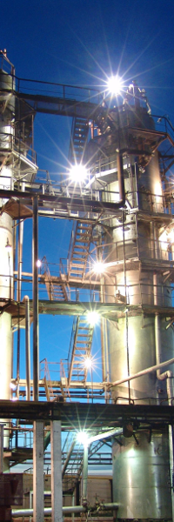
Applications in our industry
Predictive maintenance
Anomaly detection
Soft sensors (e.g. analyser data)
Predict plant upsets (plant drifts)
Finding unexpected correlations
“Black-box”-control

Slide 8
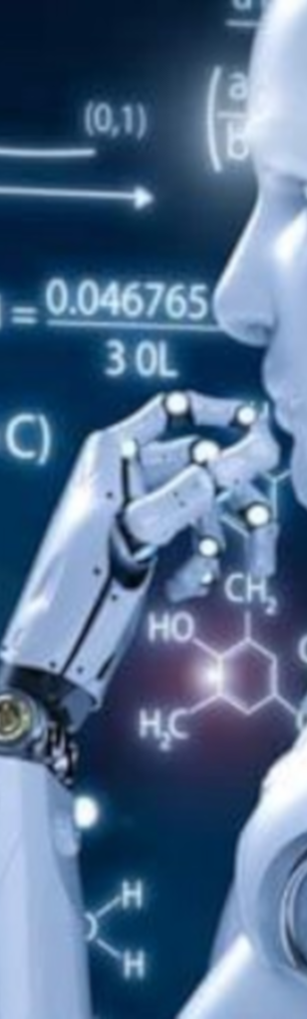
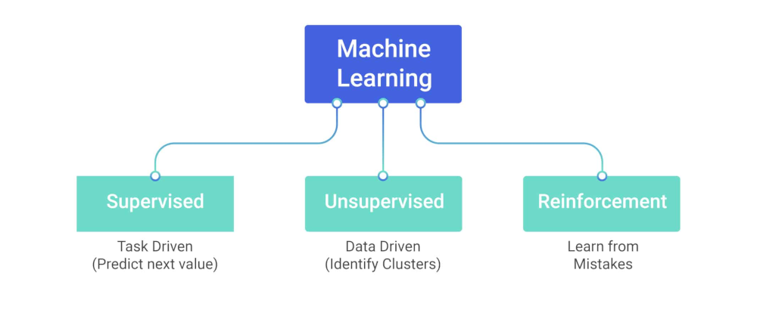
Types of Machine Learning

Slide 9
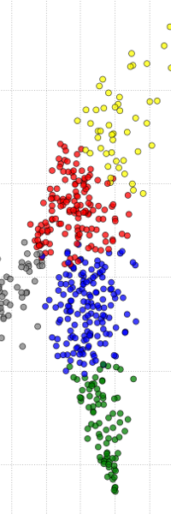
ML categorization
Supervised (labelled examples):
Regression → predict a continuous value
Classification → predict a class
Unsupervised (unlabelled examples):
Clustering → create groups
Recommender → make recommendations

Slide 10
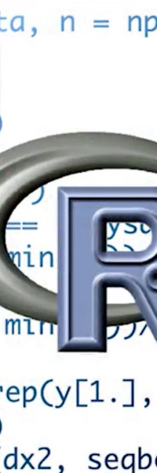
ML implementation
Matlab/Octave
Most widely used (academic origin)
Complicated
R
Big ML community
Created for analytics
Python (with scikit-learn)
Easy to use
Quite slow

Slide 11

Anaconda
Contains Jupyter Notebook (for Python) and Rstudio
You can set or download environments
No admin rights
Free

Slide 12
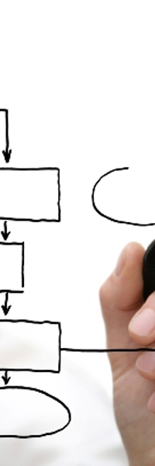
Work process ML
Dataset/Question
Feature Engineering
Algorithm
Tune
Validate
Evaluate

Slide 13
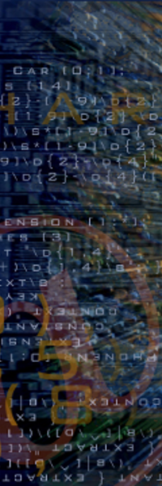
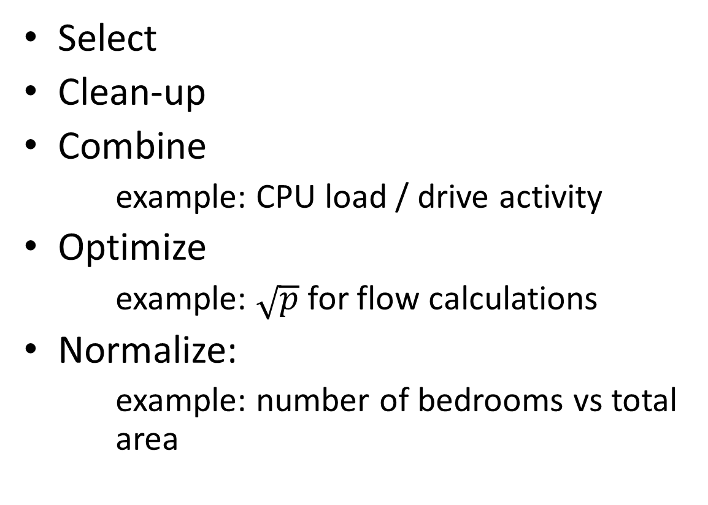
Feature Engineering
Select
Clean-up
Combine
example: CPU load / drive activity
Optimize
example: $\sqrt{p}$for flow calculations
Normalize:
example: number of bedrooms vs total area

Slide 14
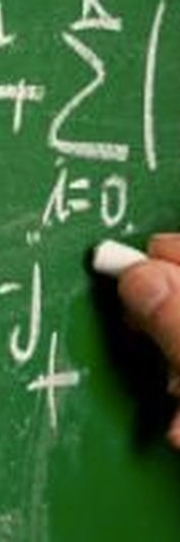
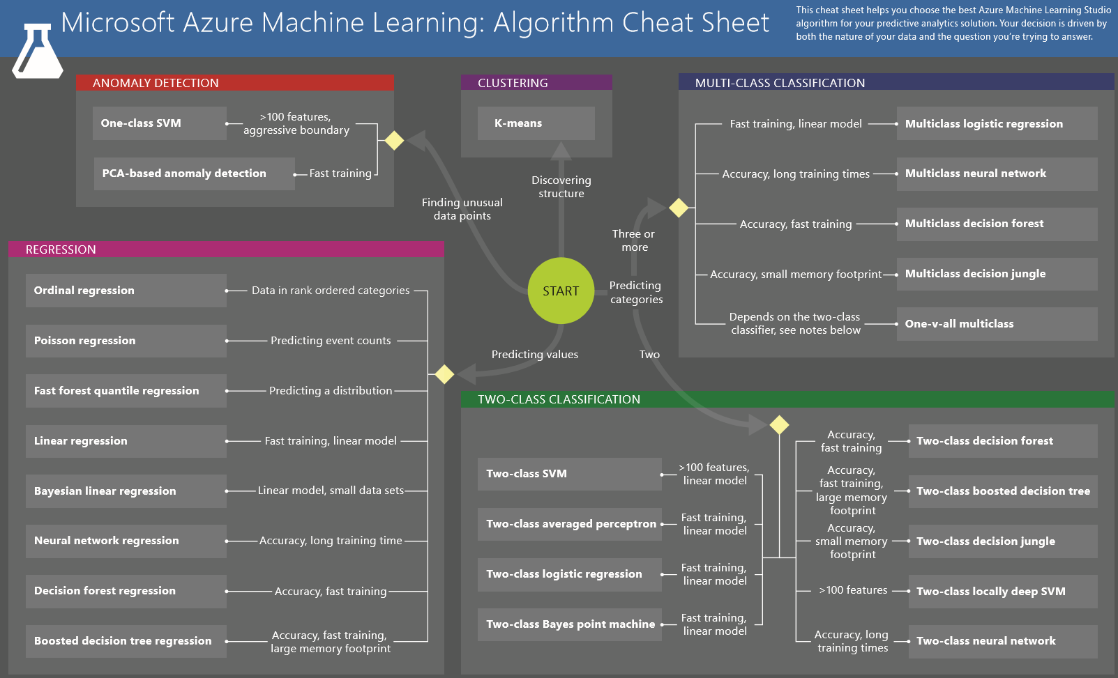
Select algorithm

Slide 15


Training, validation and test set
Training set: train the algorithm
Validation set: tune the parameters
Test set: evaluate/calculate accuracy

Slide 16
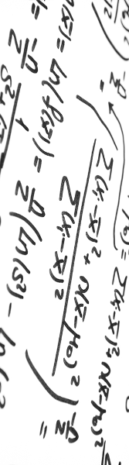
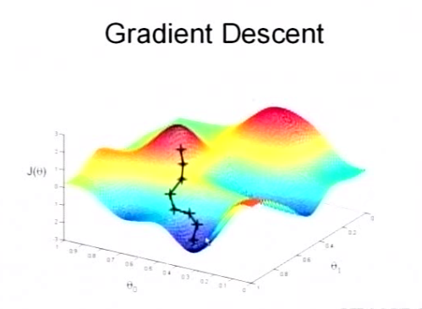
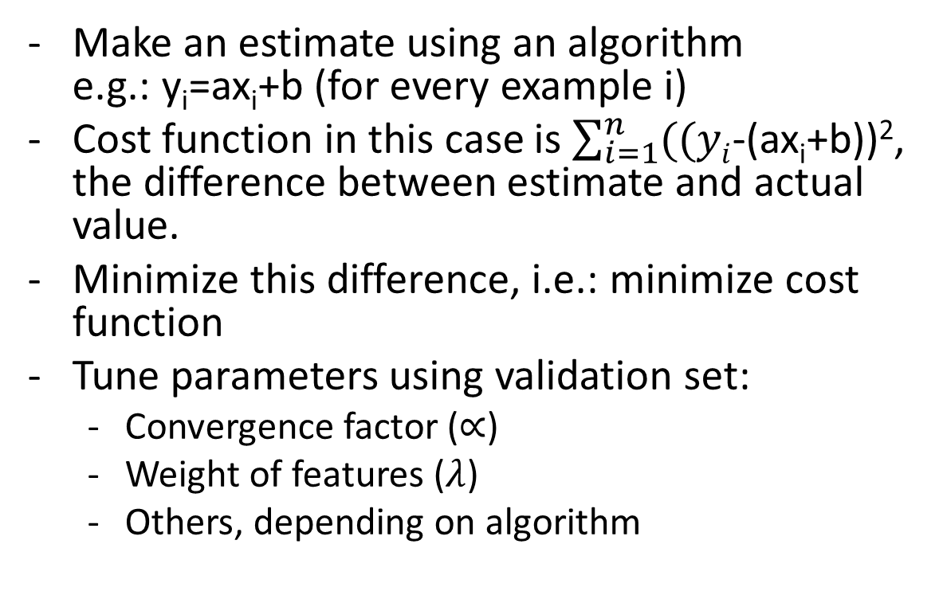
Regression: cost functions
Make an estimate using an algorithm e.g.: y_{i}=ax_{i}+b (for every example i)
Cost function in this case is $\sum_{i=1}^{n}{((yi}$-(ax_{i}+b))², the difference between estimate and actual value.
Minimize this difference, i.e.: minimize cost function
Tune parameters using validation set:
Convergence factor ($∝$)
Weight of features ($λ$)
Others, depending on algorithm

Slide 17
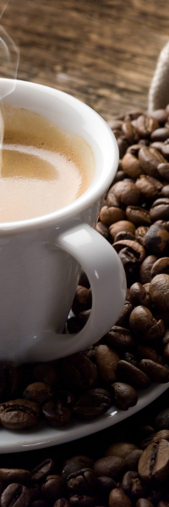
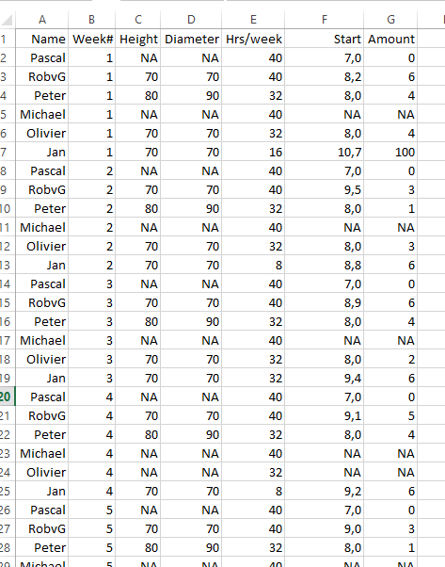
Regression example
Estimate amount of coffee taken/week
Features:
X₁: Height coffee mug[mm]
X₂: Diameter coffee mug[mm]
X₃: Duration at the office [hrs/week]
X₄: Start at the office [hrs]
Y: Amount of coffee [litres/week]
Y_{new}=Y·X₁·½ π(X₂)²
Y_{estimate}=X₁+X₂+X₁·X₂+X₃+X₄
Y_{estimate}=X₁+X₂+X₃+X₄+X₁²+X₁X₂+X₁X₃+X₁X₄+X₂²+X₂X₃+X₂X₄+X₃²+X₃X₄+X₄²

Slide 18
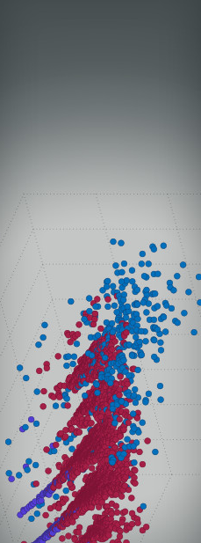
Classification:
Make an estimate using an algorithm
Evaluate algorithm
Tune parameters:
Tree size
Splitting metric
K (for K neighbours)
….

Slide 19
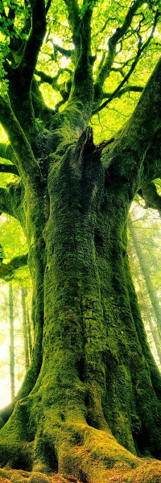

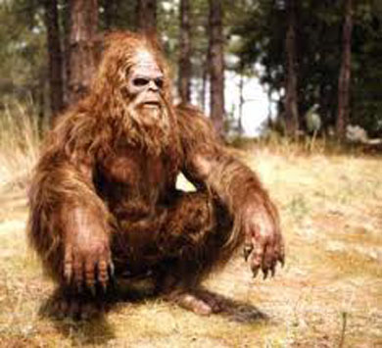
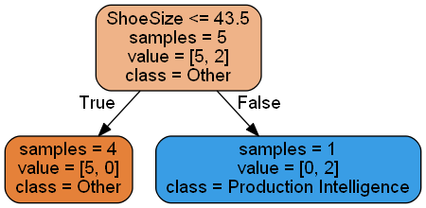
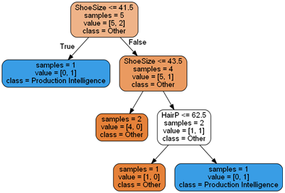
Classification example: decision tree
Name | HairYN | ShoeSize | PIMember
Pascal | 0 | 43 | 0
Frits | 1 | 44 | 1
RobV | 1 | 42 | 0
Mischa | 1 | 42 | 0
Peter | 1 | 41 | 1
RobvG | 1 | 44 | 0
Manuel | 1 | 43 | 0
Name | HairP | ShoeSize | PIMember
Pascal | 0 | 43 | 0
Frits | 100 | 44 | 1
RobV | 15 | 42 | 0
Mischa | 100 | 42 | 0
Peter | 90 | 41 | 1
RobvG | 25 | 44 | 0
Manuel | 100 | 43 | 0

Slide 20

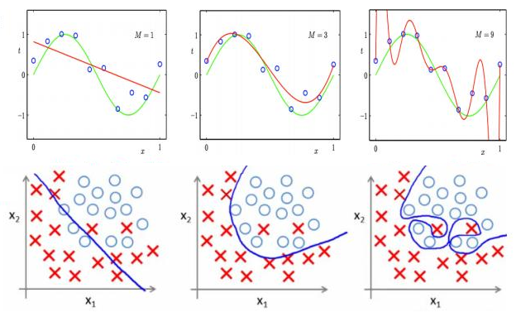
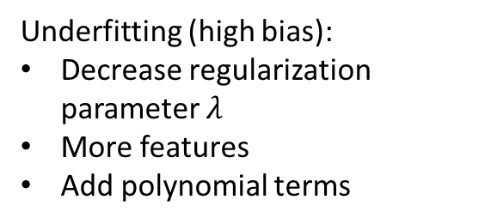
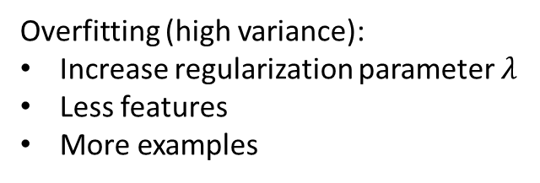
Underfitting/overfitting
Underfitting Normal Overfitting
Overfitting (high variance):
Increase regularization parameter $λ$
Less features
More examples
Underfitting (high bias):
Decrease regularization parameter $λ$
More features
Add polynomial terms

Slide 21

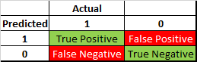
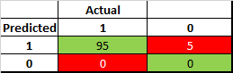
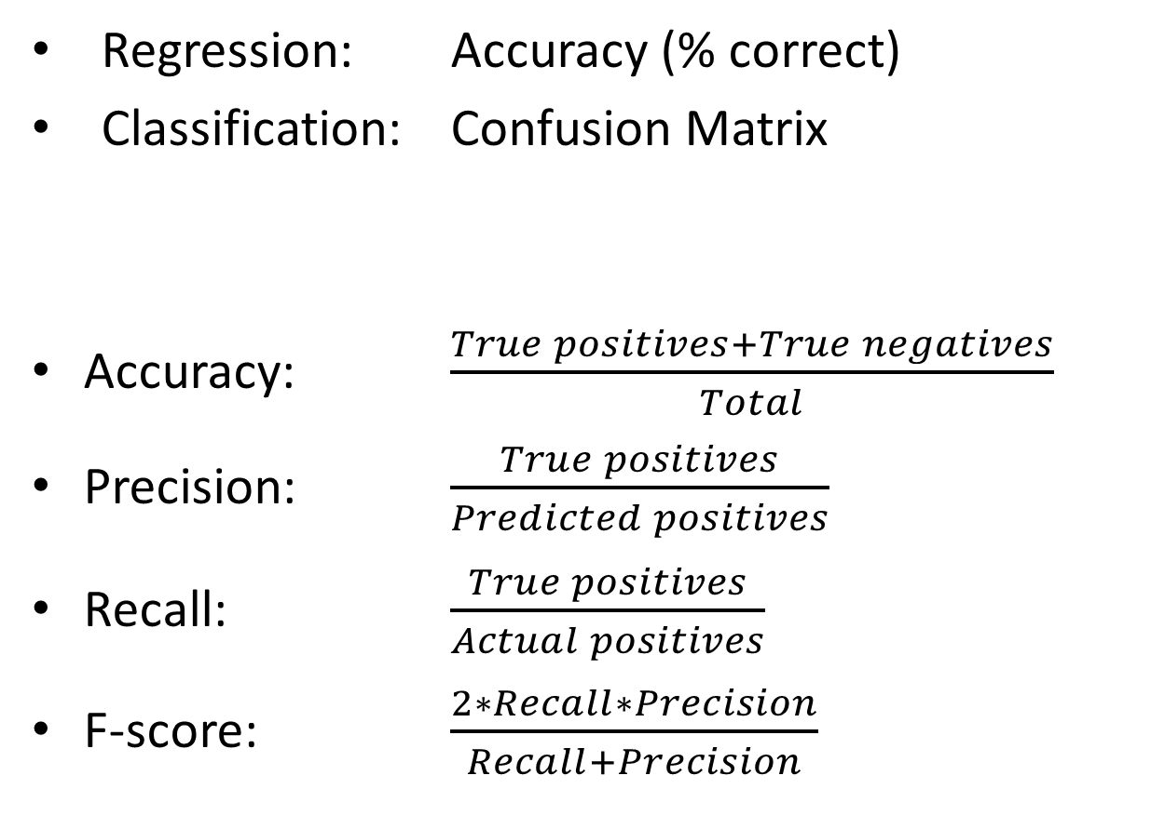
Evaluation
Regression: Accuracy (% correct)
Classification: Confusion Matrix
Accuracy: $\frac{True positives+True negatives}{Total}$
Precision: $\frac{True positives}{Predicted positives}$
Recall: $\frac{True positives}{Actual positives}$
F-score: $\frac{2∗Recall∗Precision}{Recall+Precision}$

Slide 22

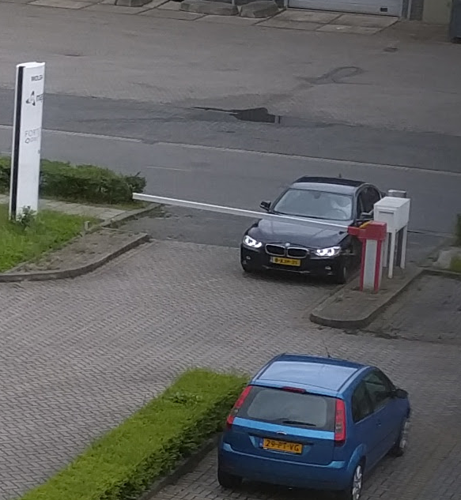
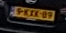
ML pipeline
Find number plate
Separate characters
Identify characters
Match Magion employee
Open gate
YES
Employee?
NO
Ask for identification

Slide 23

How to learn ML?
Learn:
Coursera
Udacity
“An introduction to statistical learning”
Practice:
Kaggle
HackerRank
UCI Machine learning repository
Magion pilots?

Slide 24
